Slide 1
Inventory Management System
Prepared By:
Name :Kachhadiya Dhruvika S
Name :Khokhani Kashish P
Department: T.Y.B.C.A Semester - 5
Guided By:
Name:Chandanimem vyas
Department: B.C.A

Slide 2
Agenda
Abstract
Introduction
Module of the project
Data flow diagram
Data dictionary
Screen Shot

Slide 3
ABSTRACT
In today's dynamic and competitive business environment, efficient inventory management stands as a critical component for the success of any retail or distribution-oriented enterprise. The Inventory Management System (IMS) presented here in is a dynamic, adaptable, and comprehensive software solution designed to cater to the intricate needs of businesses operating in diverse sectors, including supermarkets and medical stores. This project not only Fulfills the demands of managing stocks but also offers a range of features that promote seamless administration, intelligent decision-making, and enhanced operational Efficiency. The IMS embodies a two-tiered user structure, consisting of 'Users' and 'Administrators,' each equipped with specialized functions that contribute to a holistic inventory management experience. The system is developed using the PHP programming language, facilitating the creation of a robust, web-based application accessible from various devices and platforms.

Slide 4
Introduction
Our Inventory Management System (IMS) project aims to create a flexible and efficient solution for businesses like supermarkets and medical stores
Objective:
The primary objective of our Inventory Management System (IMS) project is to create a versatile and user-friendly system that caters to diverse businesses, offering comprehensive inventory management capabilities. For administrators, it provides secure and efficient inventory control, allowing management of units, purchase parties, and product details. The system supports dynamic recording of purchases and sales, tracks product expirations, generates insightful reports, and streamlines billing and returns. Users can easily manage their transactions, generate bills, and access products. In essence, our IMS enhances productivity and accuracy for various industries, irrespective of their specific needs.

Slide 5
Module of the Project
The system after careful analysis has been identified to be presented with the following modules and roles.
The modules involved are:
Administrator
Users
Above listed modules are divided into following different sub-modules.
1.Authentication
2. Unit Management
3. Party Information
4. Product Information
5. Purchase Record
6. Sales and Billing
7. Expiry Date
8. Stock Information
10. Return Management
9. Reports
12. Edit Stock
11. User Management

Slide 6
1. Authentication Module:
Objective: Ensure secure access to the system.
Functionalities:
Admin and users can register and log in.
Authentication and authorization mechanisms to control access.
Admin can log out of the system when the session is complete.
2. Unit Management Module:
Objective: Manage units of measurement for products.
Functionalities:
Admin can add, edit, and delete units (e.g., KG, LITRE, GRAMS, PIECES).
3. Party Information Module:
Objective: Manage information about purchase parties.
Functionalities:
Admin can add, edit, and delete party information (e.g., firstname, lastname, contact, address, city).

Slide 7
4. Product Information Module:
Objective: Manage product details.
Functionalities:
Admin can add, edit, and delete product information.
Include details like product name, amount, quantity, purchase party name, purchase type (cash, debit), expiry date, etc.
5. Purchase Record Module:
Objective: Keep track of purchases and update stock.
Functionalities:
Admin can add, edit, and delete purchase records.
Stock is automatically increased upon purchase.
6. Sales and Billing Module:
Objective: Manage sales and generate bills.
Functionalities:
Admin can sell items and generate bills.
Stock is automatically decreased upon sale.

Slide 8
7. Expiry Date Tracking Module:
Objective: Monitor products nearing expiration.
Functionalities:
Admin can add expiry dates for products.
View products with the nearest expiry dates.
8. Stock Information Module:
Objective: Provide real-time information on stock.
Functionalities:
Admin can view the current stock of items.

Slide 9
9. Reports Module:
Objective: Generate various types of reports.
Functionalities:
Admin can view the purchase report.
Admin can view the report of any specific party.
Admin can view day-to-day selling reports.
Admin can print stock reports.
Admin can view nearest expiry product lists.
10. Return Management Module:
Objective: Handle product returns.
Functionalities:
Admin can process returns for items.

Slide 10
11. User Management Module (Admin Only):
Objective: Admin can manage user accounts.
Functionalities:
Admin can add, edit, and delete user accounts.
User can log out of the system when the session is complete
12. Edit Stock Module (Admin Only):
Objective: Admin can manually edit stock items.
Functionalities:
Admin can edit stock items.

Slide 11
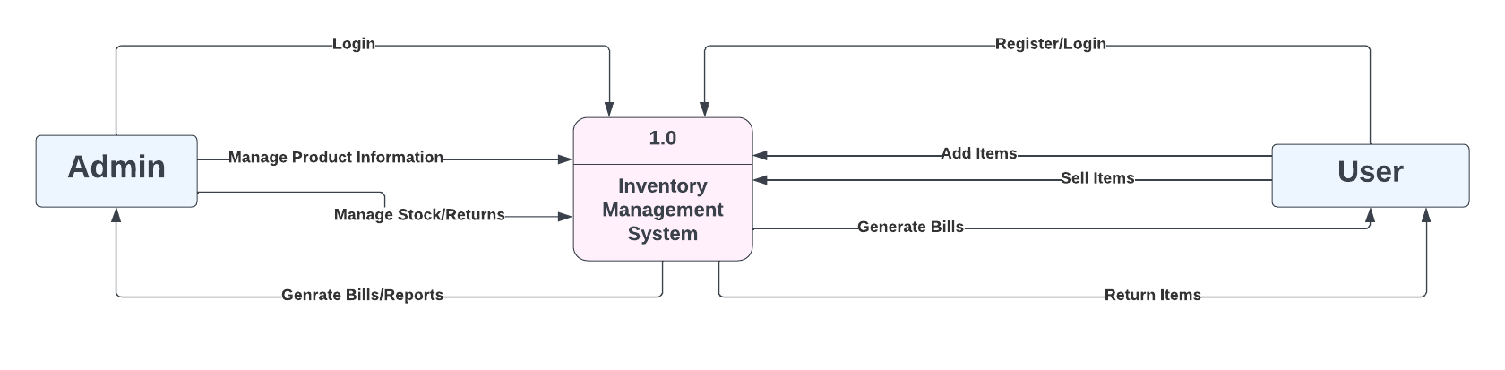
Context level Data flow Diagram
The context-level data flow diagram (DFD) describes the whole system.

Slide 12
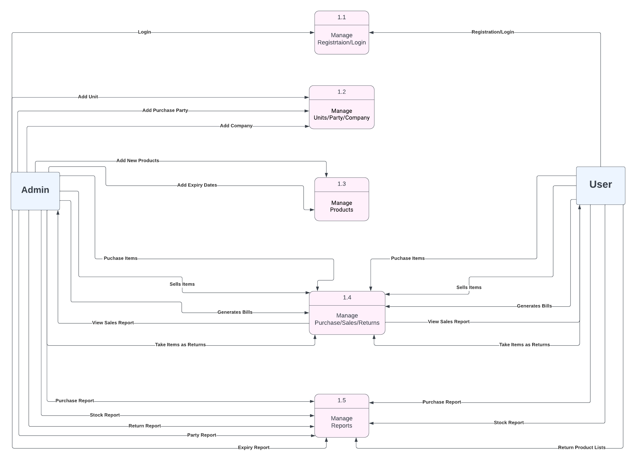
Level 1 Data Flow Diagram

Slide 13
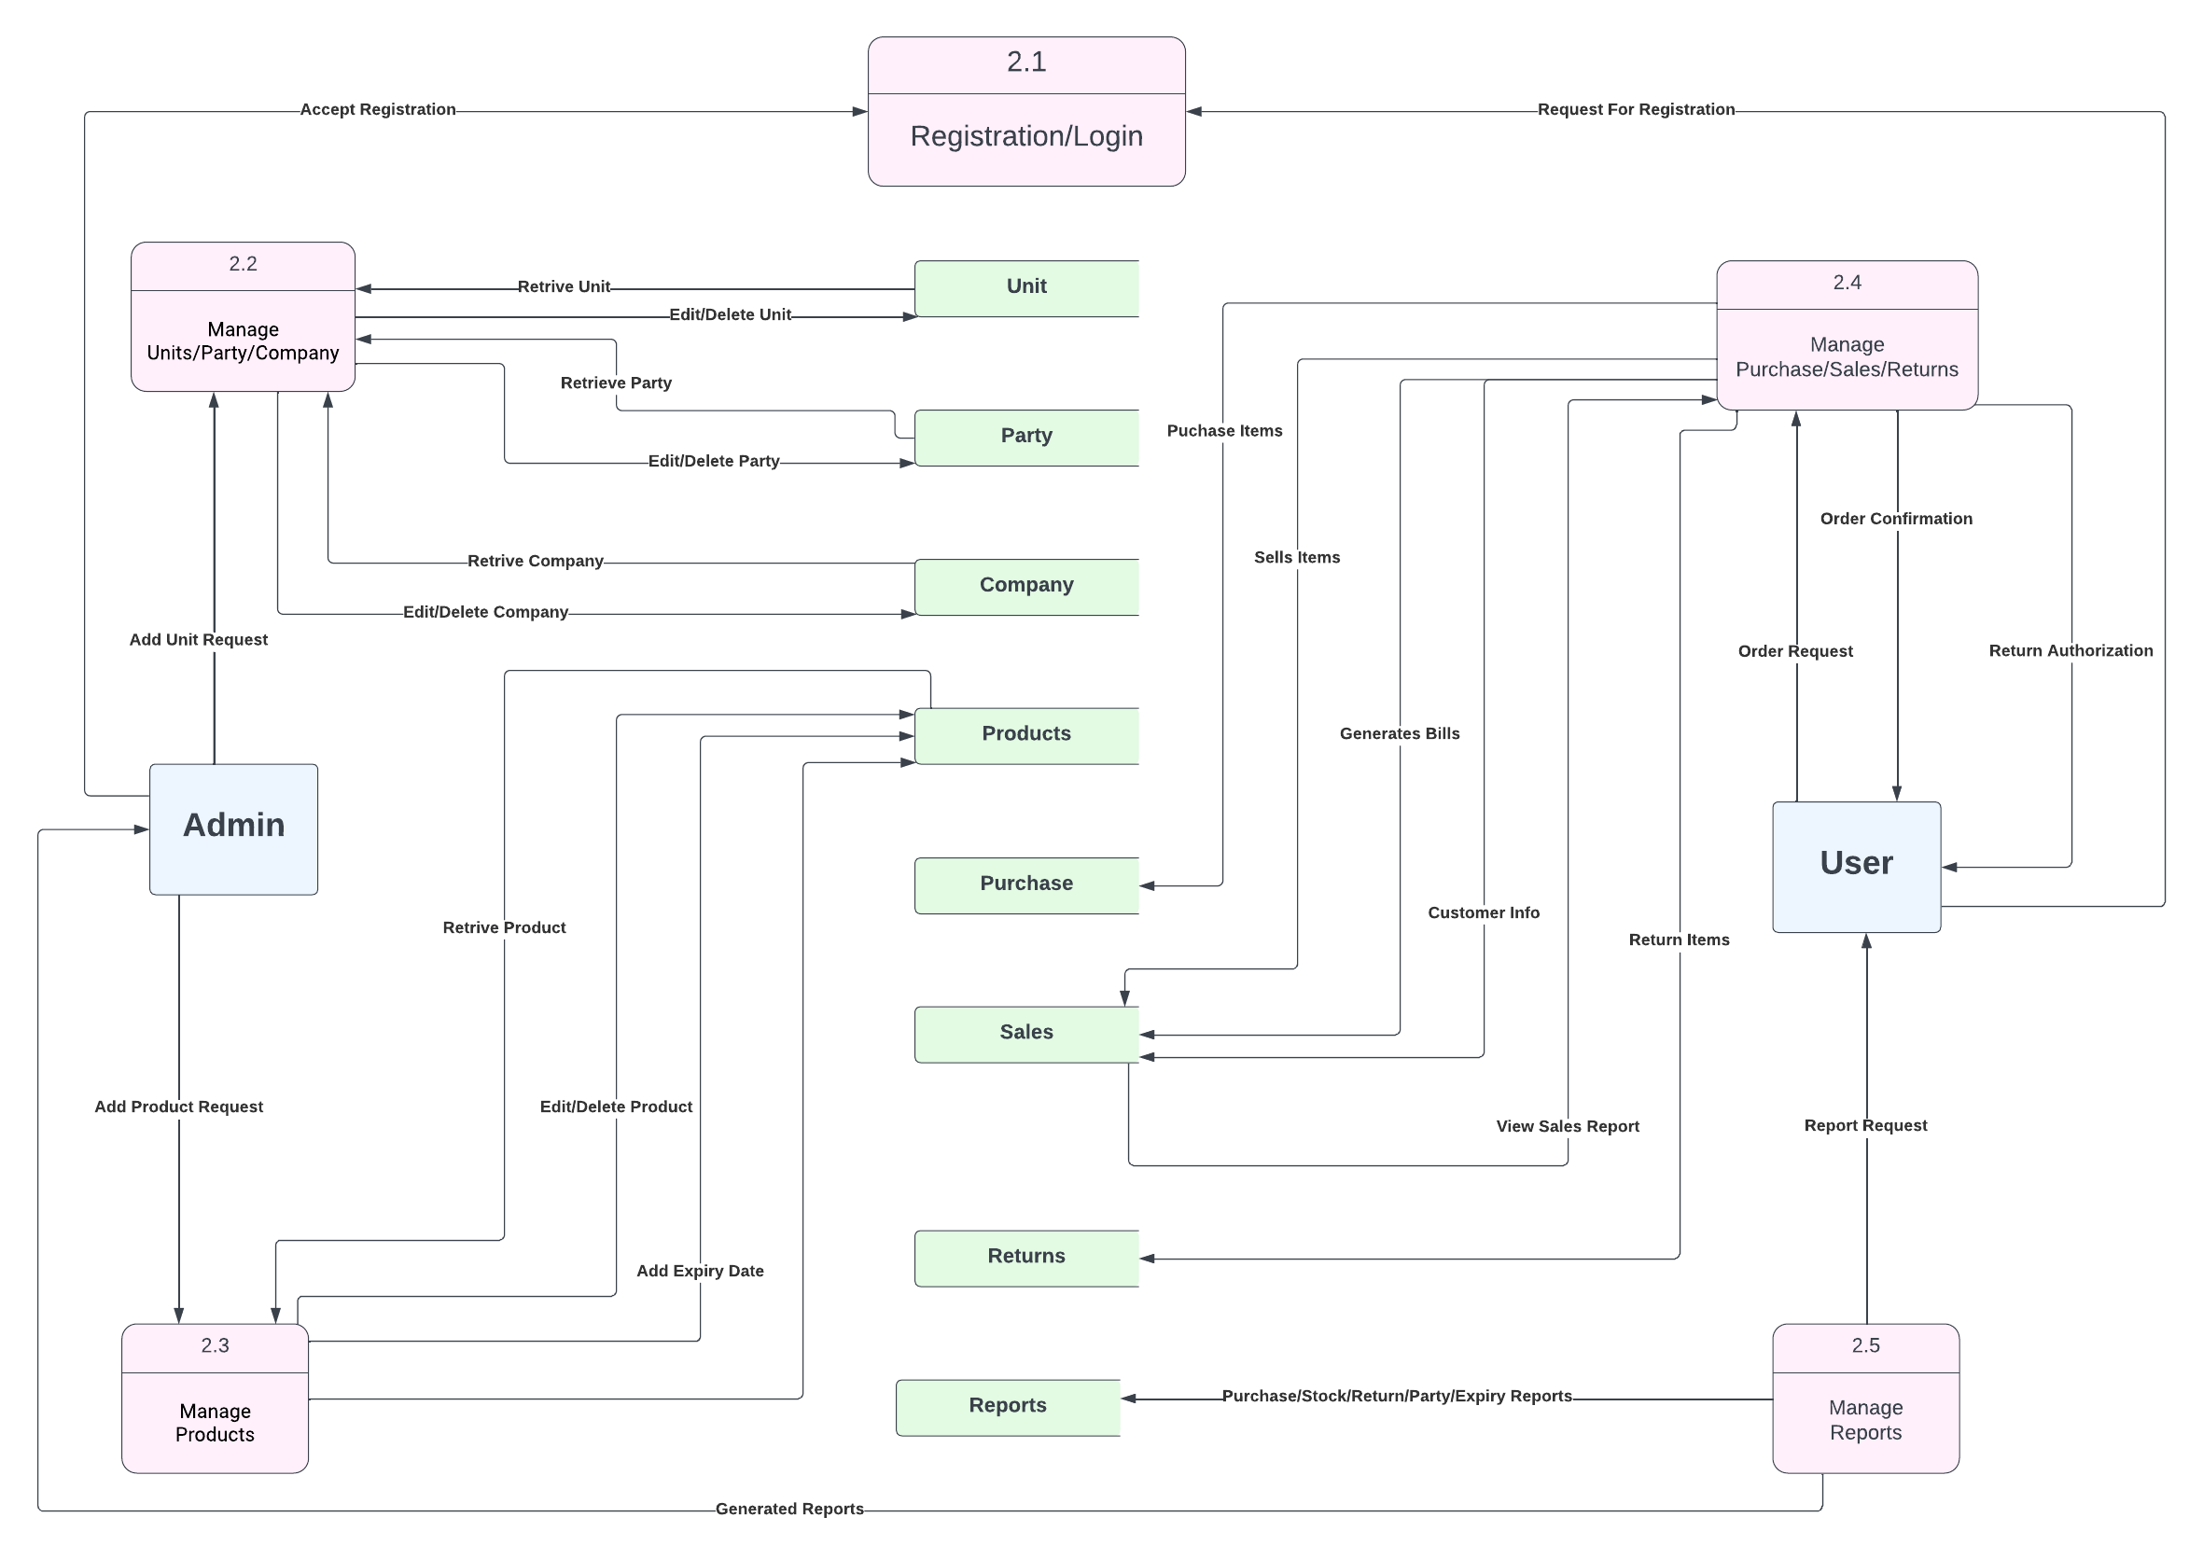
Level 2 Data Flow Diagram

Slide 14
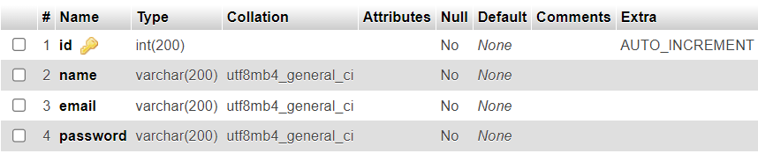
Data Dictionary
Admin login Table:
User login Table:

Slide 15

Data Dictionary
Units Table:
Company Table:

Slide 16
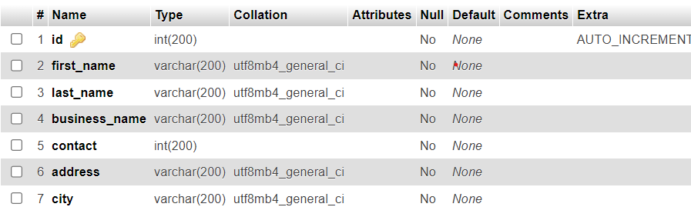
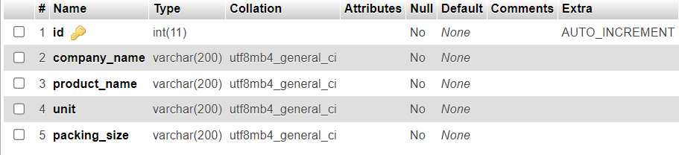
Party_Info Table:
Products Table:

Slide 17
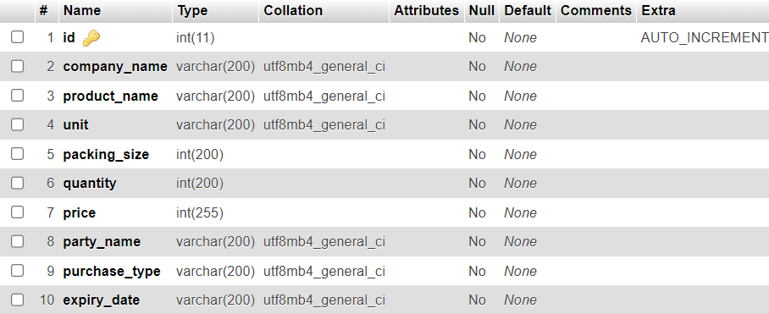
Purchase_master Table:

Slide 18
Screen Shots

Slide 19
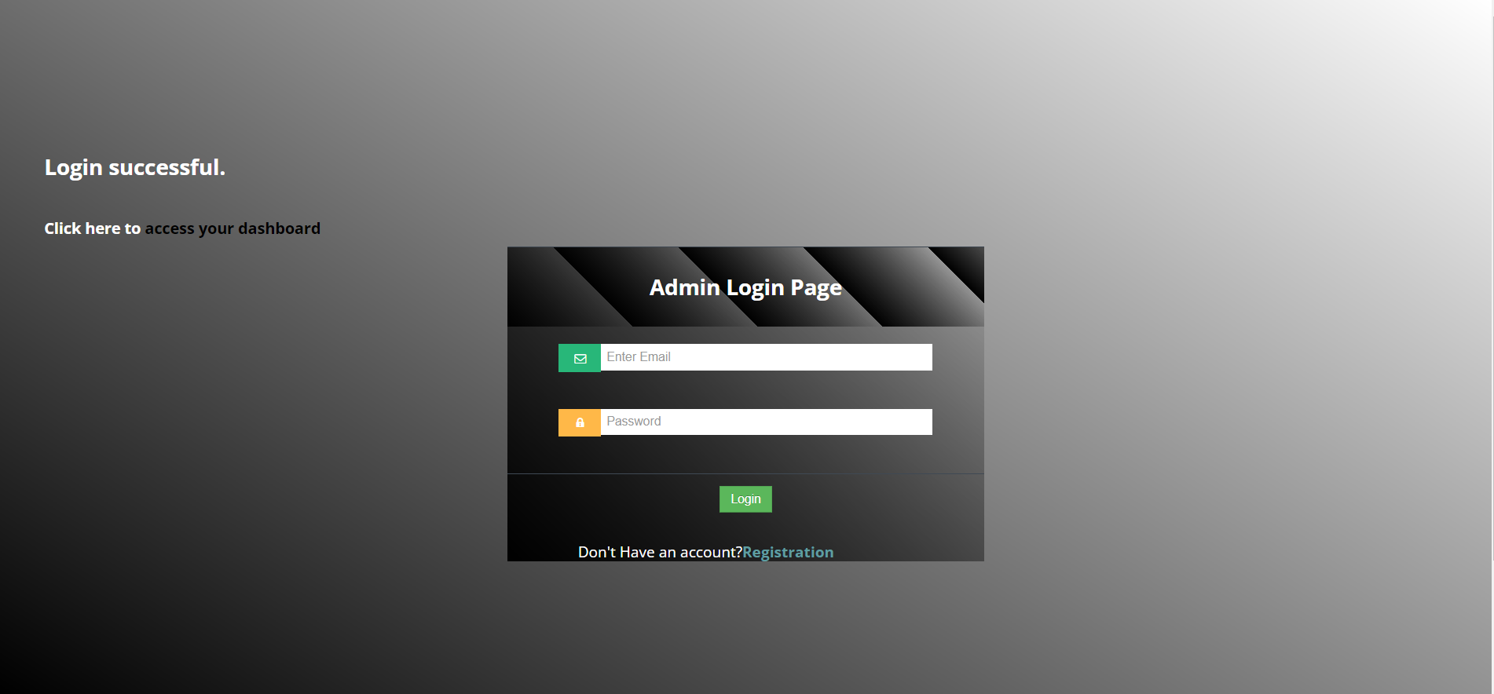
Login

Slide 20
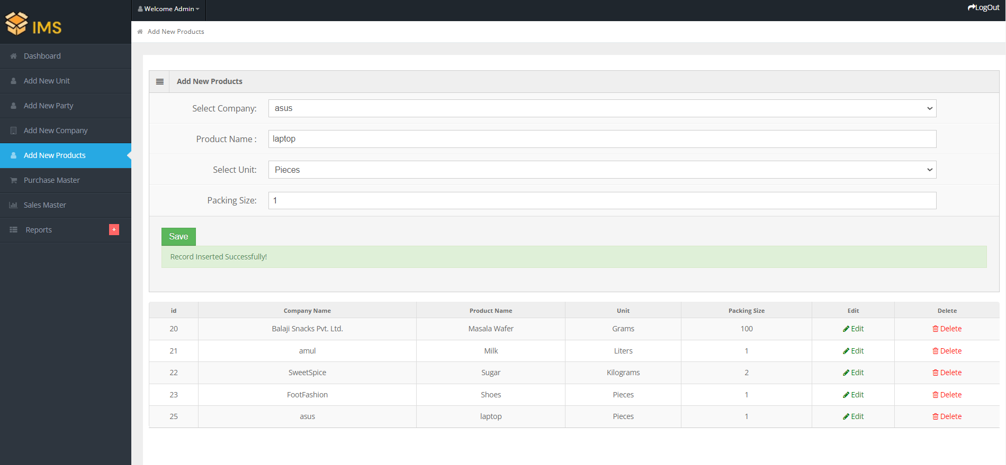
Insert Product

Slide 21
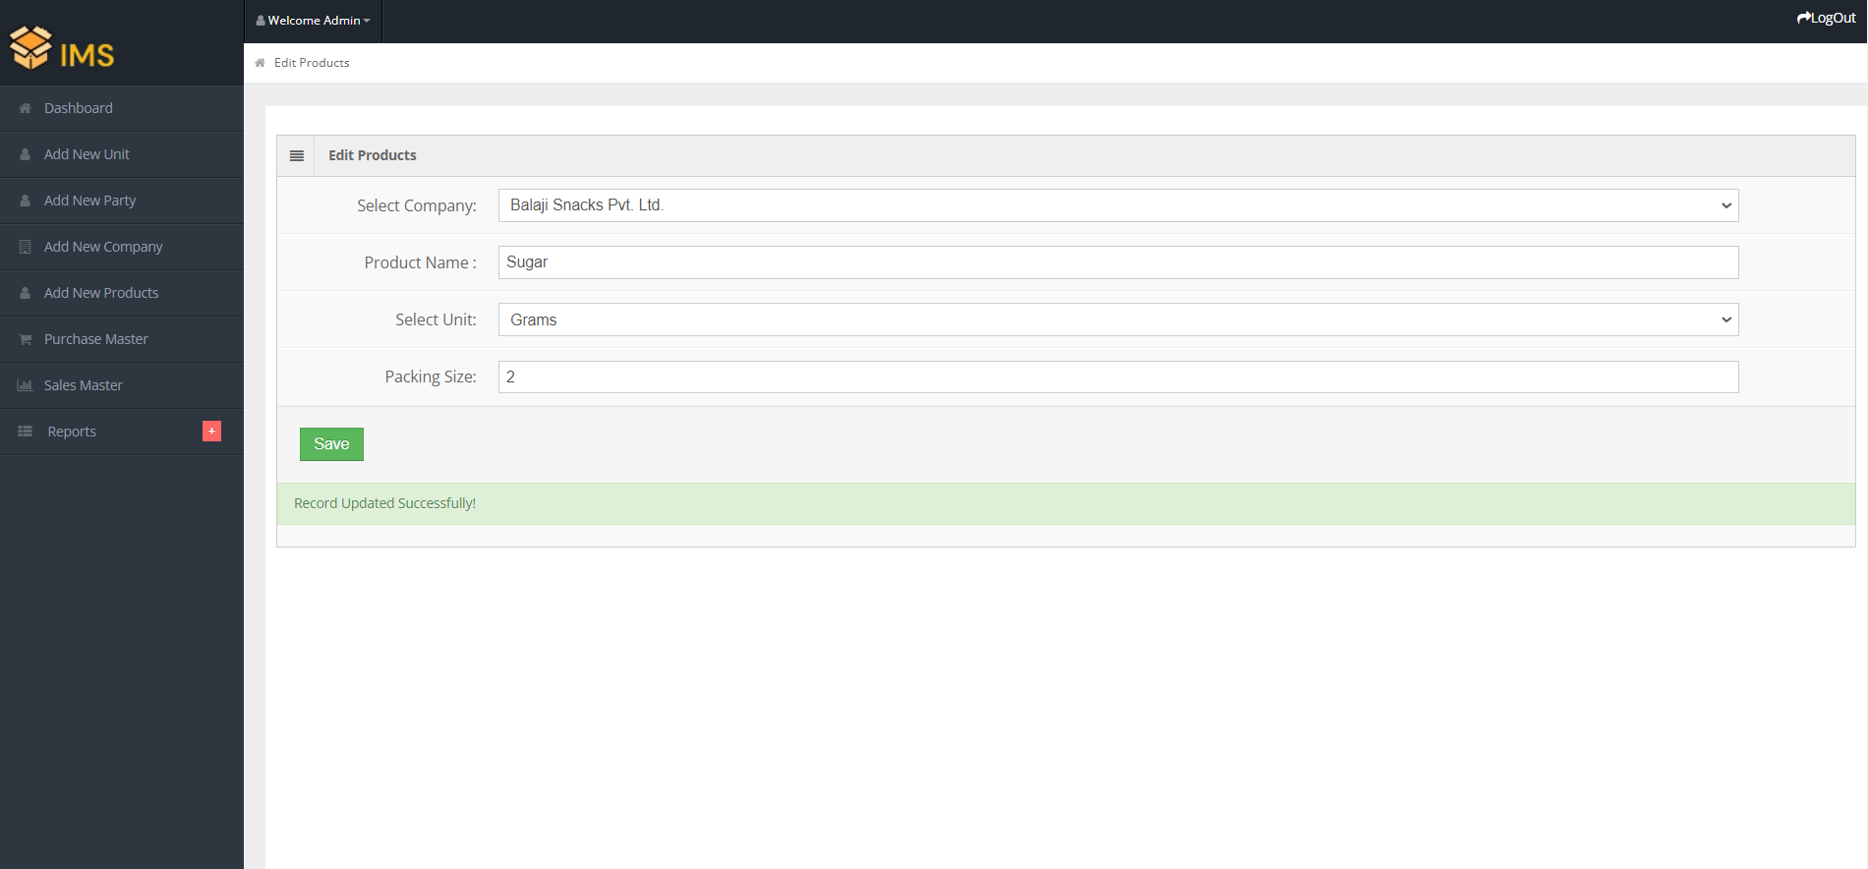
Edit Product

Slide 22
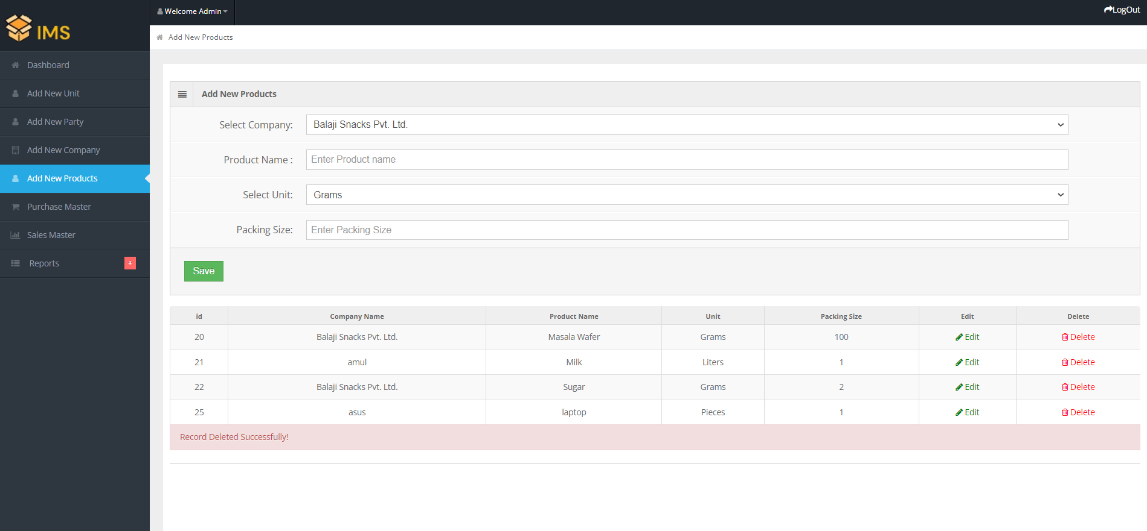
Delete Product

Slide 23
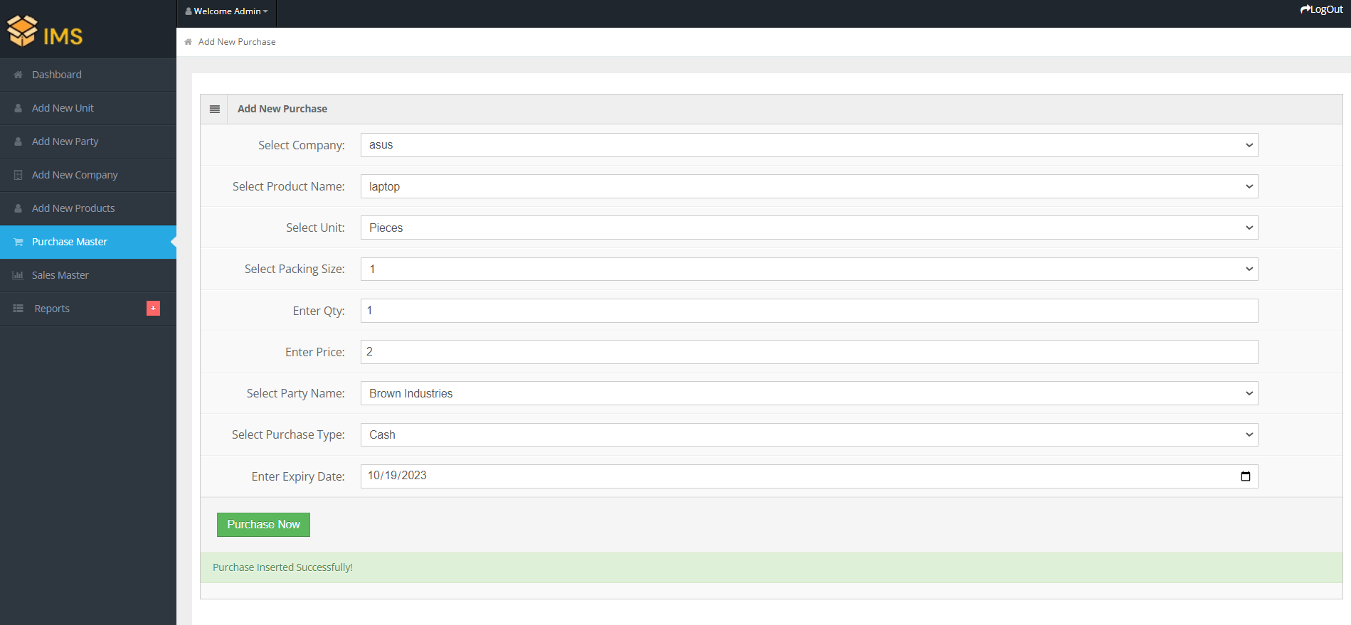
Purchase Product

Slide 24
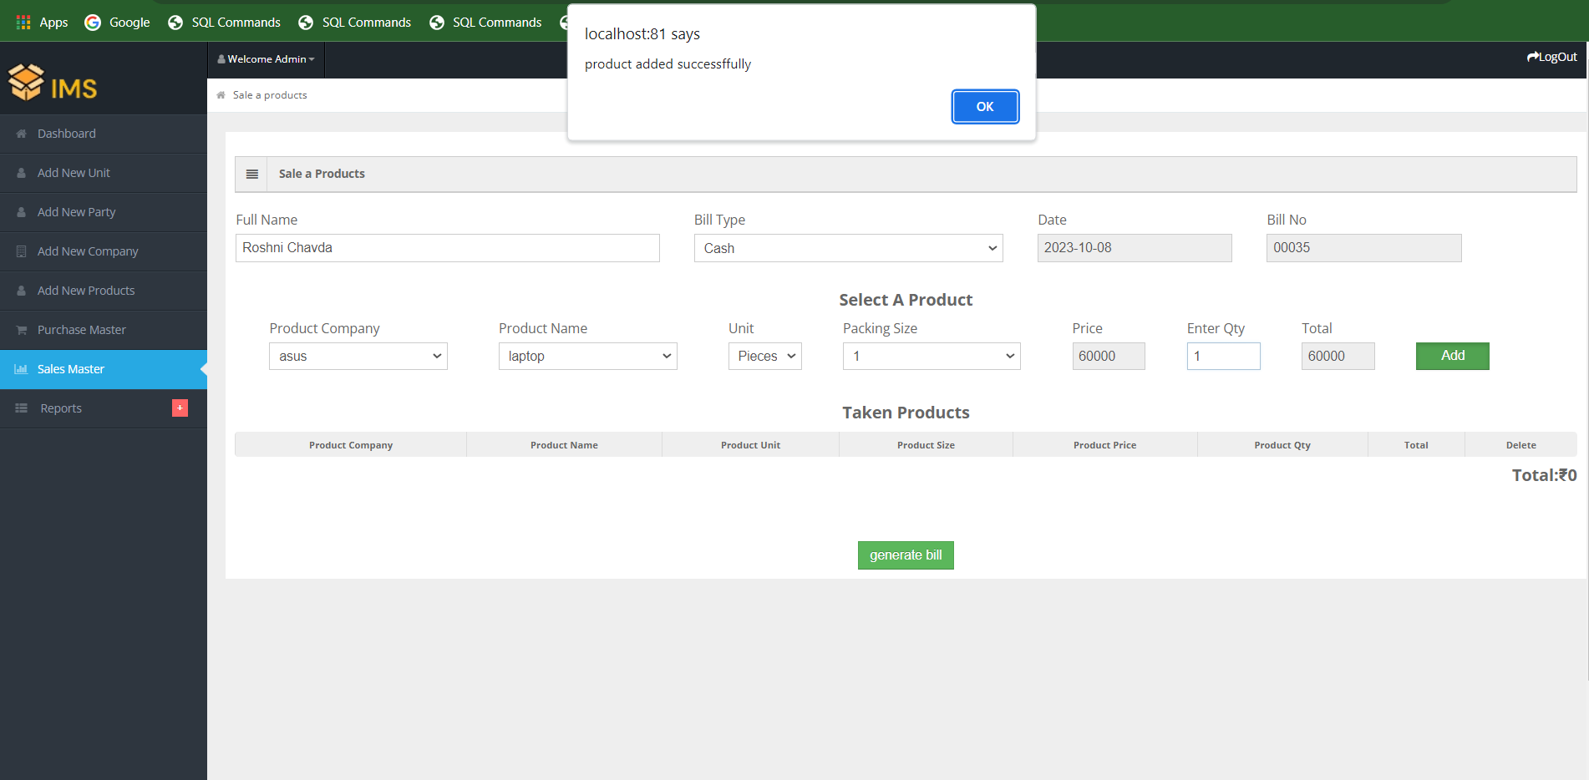
Sale a Products

Slide 25
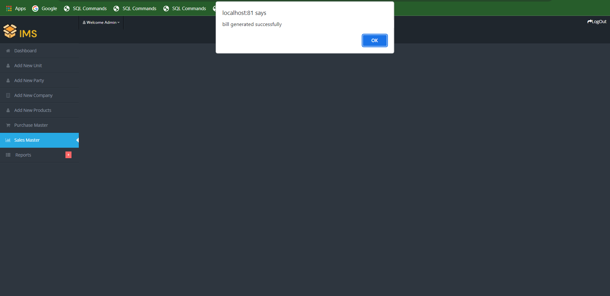
Bill Generate

Slide 26
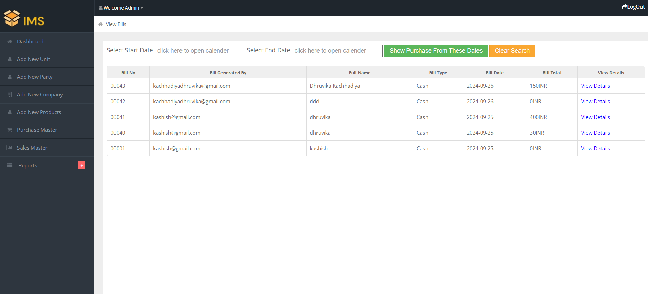
Sales Report

Slide 27
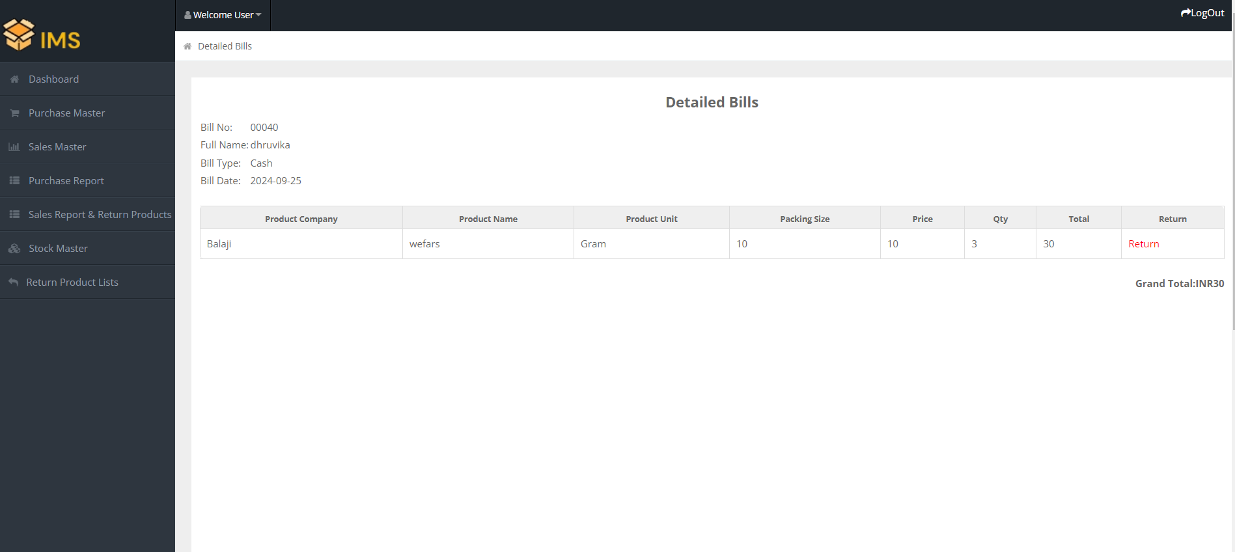
Return Product

Slide 28
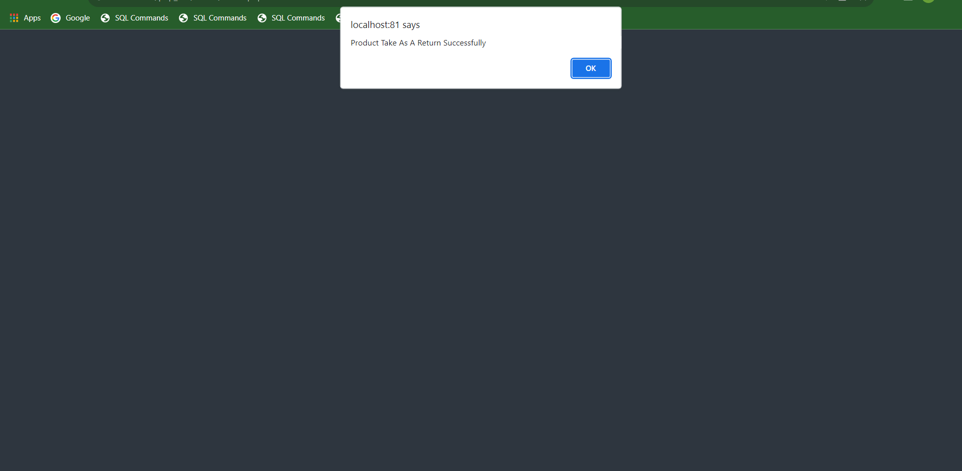

Slide 29
Thank You!!

